Slide 1


Water Loss, Use, and Conservation
(WLUC) Workshop – Part 2
Water Loss Audit Level 1 Validation
Presented by: Candice De Lello, TWDB Staff
Municipal Water Conservation
1
1
1

Slide 2
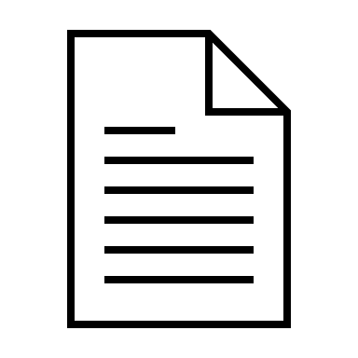
1
Overview
What is a WLA validation?
2
Purpose
What is the purpose and goals of a WLA validation?
Agenda
The purpose of this training is to provide an overview of TWDB’s validation process, its purpose, key components, and how the process benefits utilities.
3
Process
What does a WLA validation entail and what will be required of utilities?
4
Benefits
How does WLA validation benefit utilities?

Slide 3

What is a Water Loss Audit Validation?
Review of purpose and requirements

Slide 4
What is Water Loss Audit Validation?
Independent review of Water Loss Audit to ensure the accuracy and reliability of data submitted to the Texas Water Development Board (TWDB).
Level 1 Validation focuses on identifying potential errors, verifying data, and providing a realistic estimate of water loss.

Slide 5
Who Is Required?
Utilities with a current financial OBLIGATION TO TWDB
Utilities REQUESTING FINANCIAL ASSISTANCE FROM TWDB

Slide 6
Purpose of Validation: Why Validate?
Improve audit credibility and data quality
Help
Help utilities identify actionable insights to mitigate water loss
Support
Support compliance with TWDB financial assistance requirements
Promote
Promote transparency and trust between utilities and TWDB
Improve

Slide 7




Key Goals of Level 1 Validation
Verify the completeness of the submitted audit.
1
Identify data gaps, inconsistencies, or assumptions.
2
Evaluate supporting documentation for accuracy.
3
Provide utilities with a non-punitive review process to improve their audits.
4

Slide 8

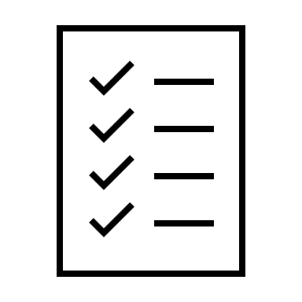


The Validation Process
WLA Submittal
Utility submits WLA
Document Request
TWDB requests supporting documentation and reviews the utility’s WLA submission and supporting documents.
Validation Interview
Collaborative discussion between TWDB and Utility to understand utility operations, data sources, and assumptions.
Validation Report
TWDB provides Utility a Validation Report with a summary of findings, recommendations, and suggested improvements (TWDB updates and resubmits WLA/WUS)

Slide 9

Completed WLA
Supporting documentation:
  System Schematic
  System Intake monthly volumes (by source) and meter testing/calibration reports.
  Billed Metered, Billed Unmetered, Unbilled Metered, and Unbilled Unmetered monthly volumes (by class/type) and meter testing reports.
  Breaks and Leaks documentation
  Retail Price of Water calculation
  Variable Production of Cost calculation
  Pre-Validation Questionnaire
Staff present for the validation interview.
What Utilities Need to Provide

Slide 10
Documentation Examples
System Intake (Wrong vs. Right) – WRONG
Wrong documentation often includes:
Only providing total system intake volumes for the entire utility without breaking down data by individual sources or meters, such as import or export meters.
Submitting incomplete or missing records for monthly intake volumes.
Misclassifying raw water as potable water, or not distinguishing between the two, which can result in overstated or inaccurate water loss figures.

Slide 11

Documentation Examples
System Intake (Wrong vs. Right) – RIGHT
Line 13 (Produced Water)
Line 12 (Volume of Water Intake)
Line 14 (Total Treated Purchased Water)

Slide 12

Documentation
Avoid Errors in Total System Input Volume
Incomplete or generalized data can result in inaccurate calculations.
Total System Input Volume is a key metric for determining water losses.
Separate Potable and Raw Water
Water loss audits focus on potable water.
Raw water data, while verified for line 12 (volume of water intake), must be clearly distinguished.
Enhance Credibility of Audit
Detailed, source-specific records show commitment to accurate reporting.
System Intake – Why Accurate Documentation Matters

Slide 13
Documentation Examples
Billed Metered (Wrong vs. Right) – WRONG
Wrong documentation often includes:
Submitting data in inconsistent or unclear formats that don’t align with what was submitted in the Water Use Survey for line 17 (billed metered consumption).
Providing only a total billed metered volume without monthly breakdowns or categorization by customer types like residential, commercial, or industrial.

Slide 14
Documentation Examples
Billed Metered (Wrong vs. Right) – RIGHT

Slide 15

Documentation
Ensure Accurate Authorized Consumption
Incomplete documentation affects audit results.
Errors in line 17 (billed metered consumption) can misrepresent real and apparent water losses.
Promote Transparency in Billing Practices
Clear categorization of billed volumes (e.g., residential, commercial) aids validation.
Transparency builds trust between utilities and TWDB.
Align with Water Use Survey Format
Consistent formatting minimizes delays in validation.
Simplifies cross-referencing and ensures smoother review processes.
Billed Metered– Why Accurate Documentation Matters

Slide 16
What Is Asked During Validation?
Information to better understand system.

Slide 17
Example Questions
Where are boundary meters located?
What treatment process does the utility use?
Does the utility hand transcribe meter readings or utilize SCADA?
Does the utility have a billing software?
How old are the utilities customer meters?

Slide 18
Benefits to Utilities
Improved data confidence for decision-making and capital planning.
Access to expert feedback and recommendations.
Better understanding of water loss metrics and root causes.
Support for funding applications and compliance.

Slide 19




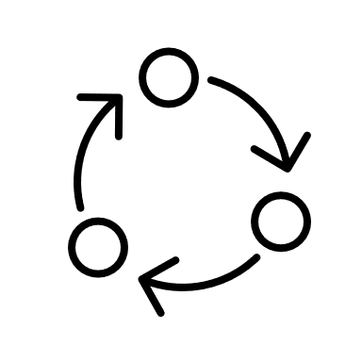
Taking Action
Refine data gathering and information
Metering assessment, testing, or replacement program
Leak detection
Pipe repair or replacement
Operation and maintenance programs and changes
Administrative processes or policy changes

Slide 20
FAQs
Q: Is the process mandatory?
A: Yes, for utilities with financial obligations to TWDB or seeking financial assistance.
Q: Is this process punitive?
A: No, it is designed to support utilities in improving their data and operations.
Q: What happens if errors are found?
A: TWDB will update WLA/WUS as necessary and provide recommendations to Utility.
Q. Who can complete validations outside of TWDB?
A. Approved third party validators (by TWDB) are permitted to validate a Texas utility’s WLA. Must provide a training certificate from an approved provider. Must be a person other than the auditor.

Slide 21
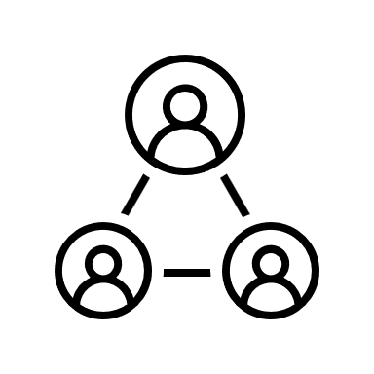
Resources
TWDB Water Loss Audit
AWWA M36 Manual
Water Resource Foundation 5057
TWDB Website - Validation
TWDB Staff – 512.463.0987 or WLA-Group@twdb.texas.gov

Slide 22
Questions?
Candice De Lello
512.463.0987
WLA-Group@twdb.texas.gov

